Slide 1
Bicycle Rental System
By
Sabhareeswaran S

Slide 2


Agenda
A
Introduction
Existing Solution
Proposed Solution
Software Requirements
Frontend and Backend
Modules and Screenshots

Slide 3
Introduction
Bicycles have evolved significantly in recent years, integrating smart technology to enhance functionality and user experience. From navigation systems to anti-theft measures, smart bikes are revolutionizing the way we ride. Let's delve into the methodology, innovation, features, applications, and solutions offered by some of the leading smart bi-cycle models available today.

Slide 4
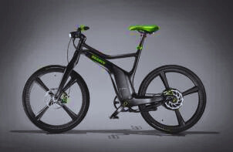
Existing Solution
In India, bicycle rental systems like Yulu, Zoomcar PEDL, and Smart Bi-Cycle have gained traction across cities like Bengaluru, Mumbai, and Delhi, offering eco-friendly transportation solutions.
These systems, accessible via mobile apps, provide both standard and electric bicycles for rent, promoting sustainable and convenient urban mobility options for residents and tourists alike.
The features like theft detection, secure payment processing, payment features , etc are lacking in the existing system.

Slide 5
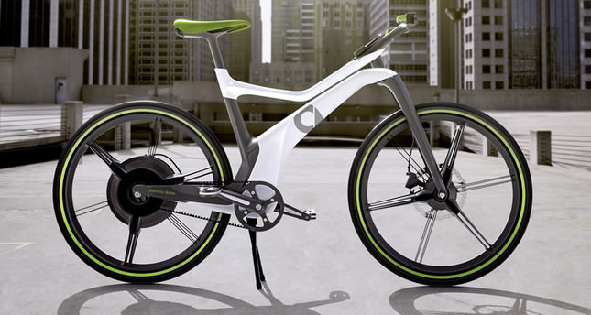
Proposed Solution
The features like booking the slots for riding, easier payment gateway, allows users to add bicycle for rent, providing users to calculate the fare for the time slots are the features are added.
Adding to that, securing the payment, and to provide the accessibility by the user, allocating cycles for the user.
This is my proposed solution for the current problems faced by the user.

Slide 6
Software Requirements
The software required are
Web browser-Google Chrome
ReactJS, CSS, Javascript, ExpressJS
VS Code - IDE
MongoDB Atlas

Slide 7
Modules
The Modules are
Registration Page
Bi-Cycle Adding Page
Booking Page
Payment Page

Slide 8
Registration Page
In a Bicycle Rental System, the login module plays a critical role in ensuring secure and streamlined access for users, administrators, and other stakeholders. Here’s a comprehensive description of the login module:
The login module is designed to authenticate users, administrators, and other authorized personnel, allowing them access to the system's features based on their roles. This module ensures that only registered and verified individuals can interact with the system, maintaining security and preventing unauthorized access.
The login module can be access after registered the account in the page.

Slide 9
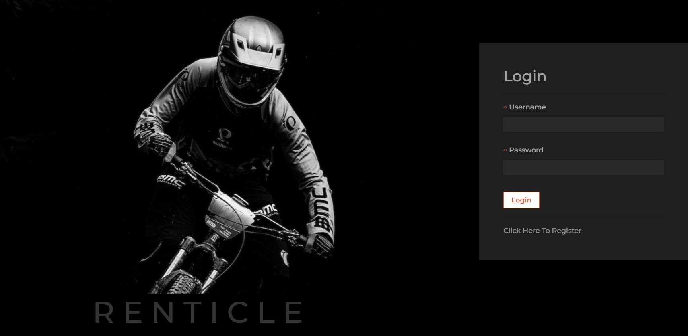
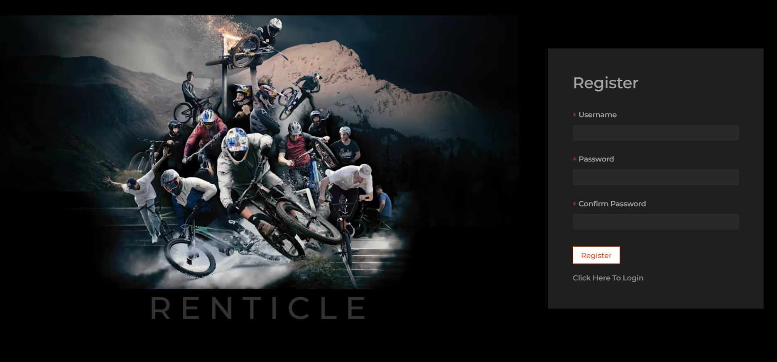
Registration Page

Slide 10
Bi-Cycle Adding Page
The Bike Adding Module is a crucial component of the bicycle rental system designed to streamline the process of incorporating new bicycles into the rental fleet. This module allows administrators to efficiently add new bikes, ensuring they are properly categorized, tracked, and maintained within the system.
Basic Information: Fields to input the bike’s unique identifier (ID), make, model, type (e.g., road, mountain, electric), and color.
Specifications: Detailed attributes including gear count, frame size, and additional features (e.g., basket, lights).
Condition and Status: Options to mark the bike’s condition (new, used, refurbished) and its current status (available, under maintenance, rented).

Slide 11
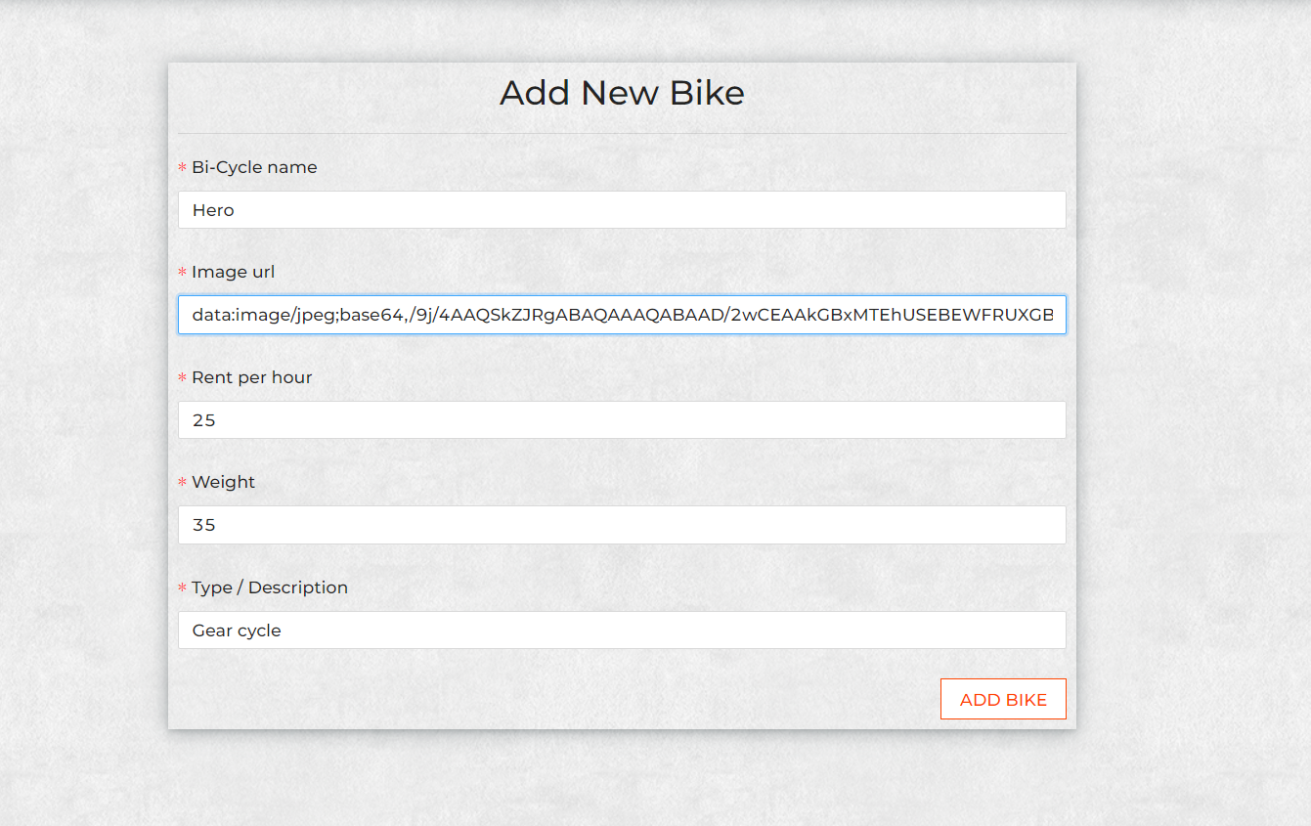
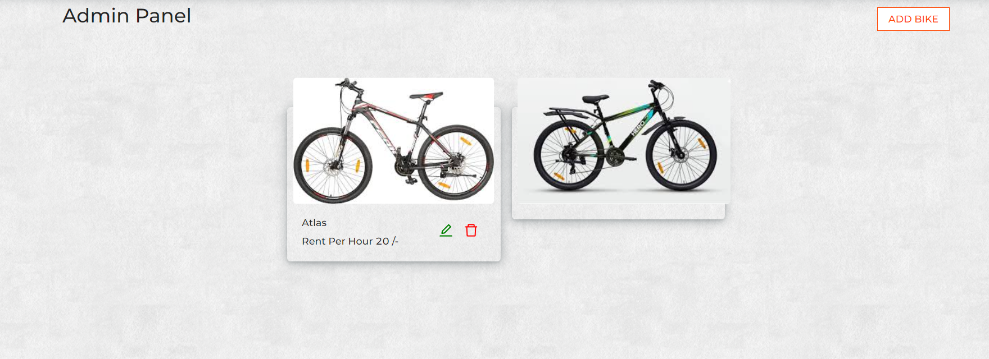
Bi-Cycle Adding Page

Slide 12
Booking Page
The booking module is a core component of the bicycle rental system, designed to facilitate seamless reservation, management, and tracking of bicycle rentals. This module ensures a user-friendly experience for both customers and administrators, providing efficient handling of the entire booking lifecycle.
Booking Form: A user-friendly form to collect booking details, including rental duration, pickup and drop-off locations, and any additional services or accessories.
Price Calculation: Automatically calculates the total rental cost based on selected options, rental duration, and any applicable discounts or promotions.
Confirmation: Sends a booking confirmation via email or SMS with detailed information about the reservation, including a unique booking ID.

Slide 13
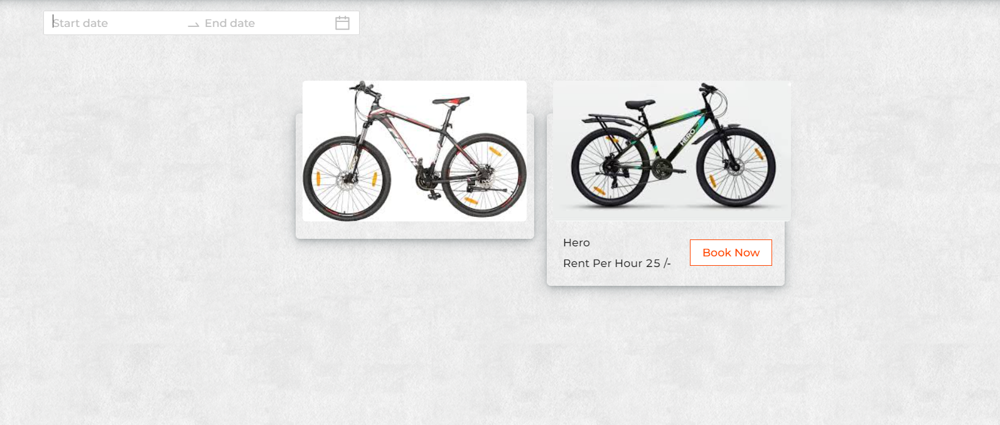
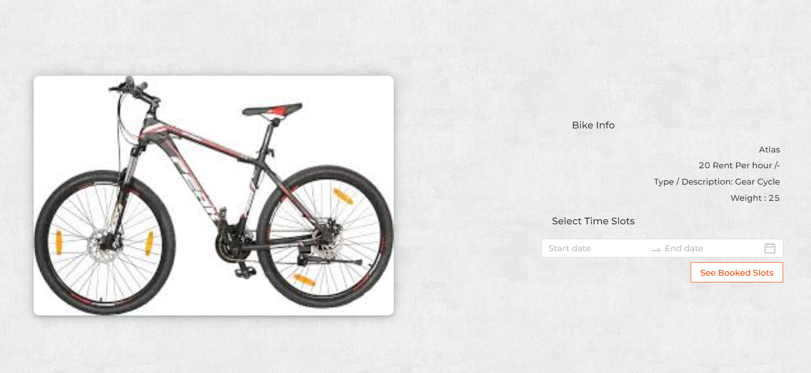
Booking Page

Slide 14
Payment Page
The payment module for the bicycle rental system will allow users to securely pay for their bicycle rentals using either PayPal or Stripe. This module will handle various payment-related tasks, including:
User authentication and authorization
Payment processing
Transaction management
Secure data transmission
Payment Gateway: Integrates with secure payment gateways to accept various payment methods, including credit/debit cards, digital wallets, and bank transfers.
Payment Status: Tracks the status of payments and provides users with receipts and payment confirmations.
View Bookings: After payment, allows users to view their upcoming and past bookings, including details and status.

Slide 15
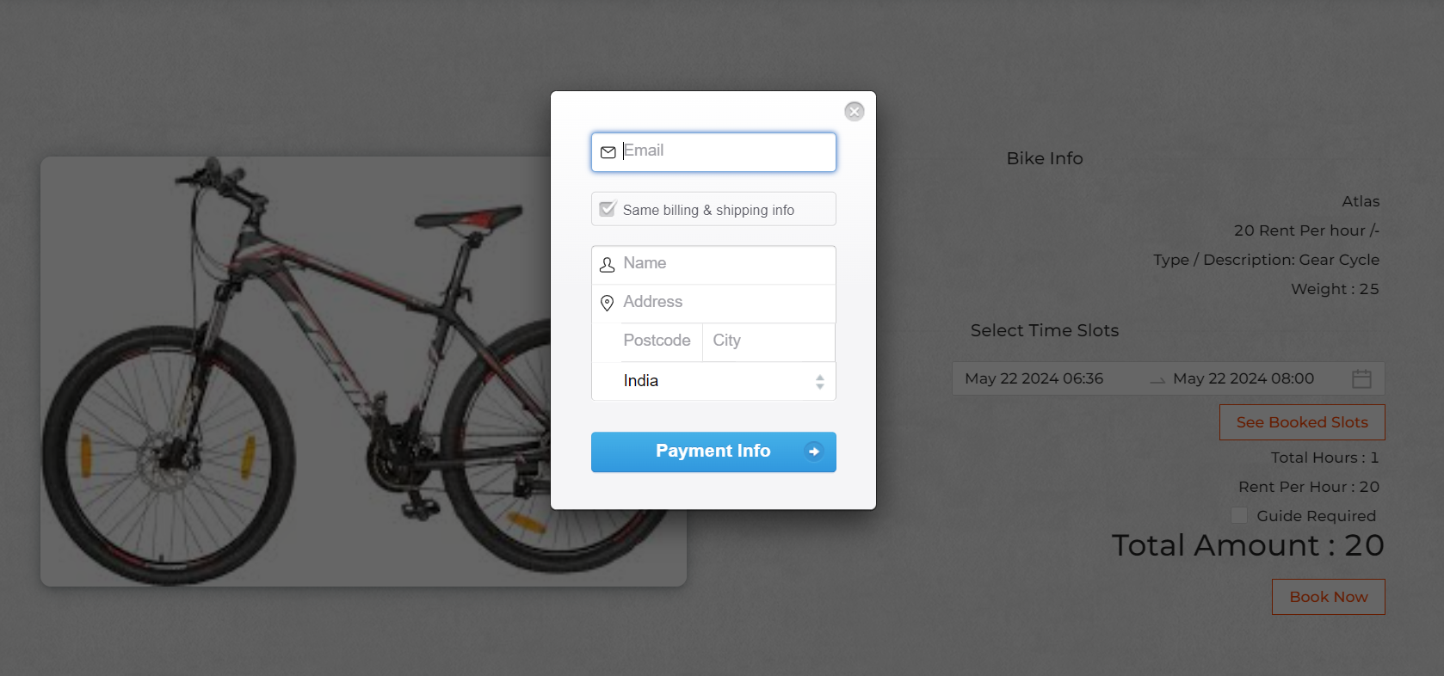
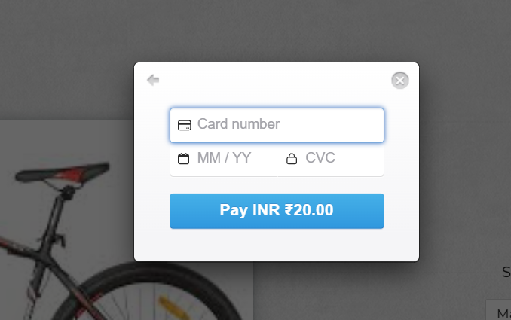
Payment Page

Slide 16
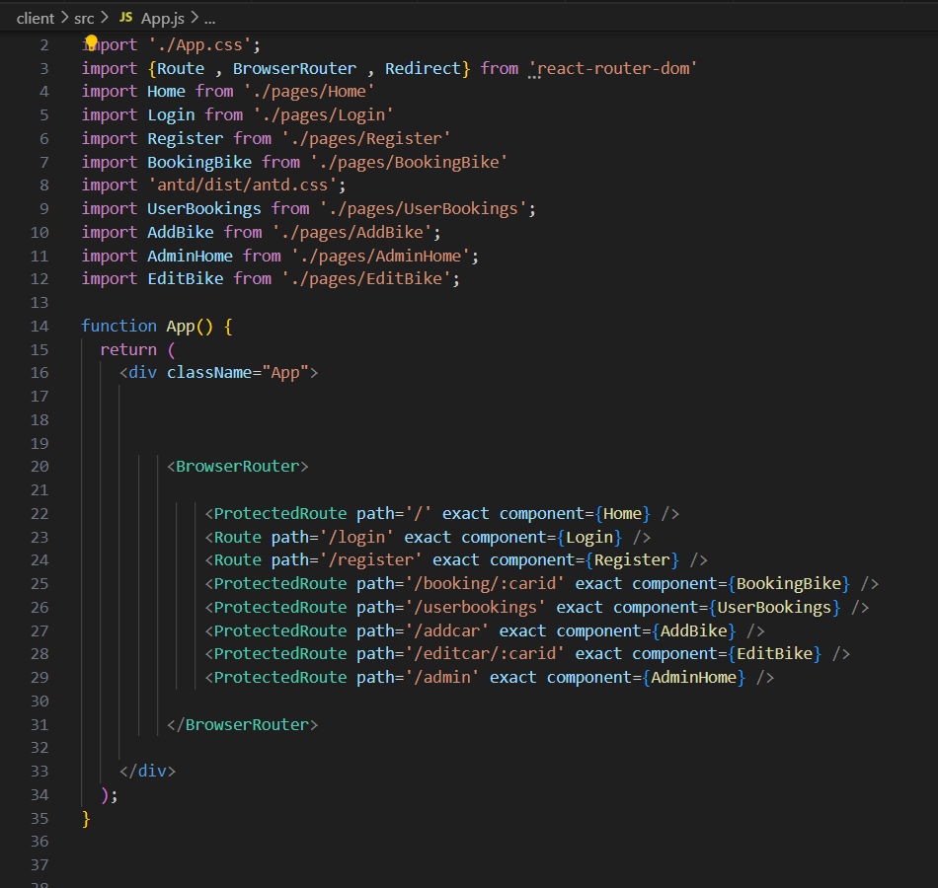
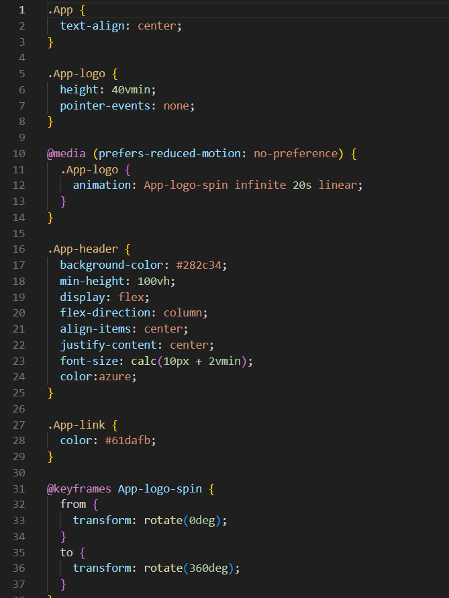
Frontend Code Screenshots

Slide 17
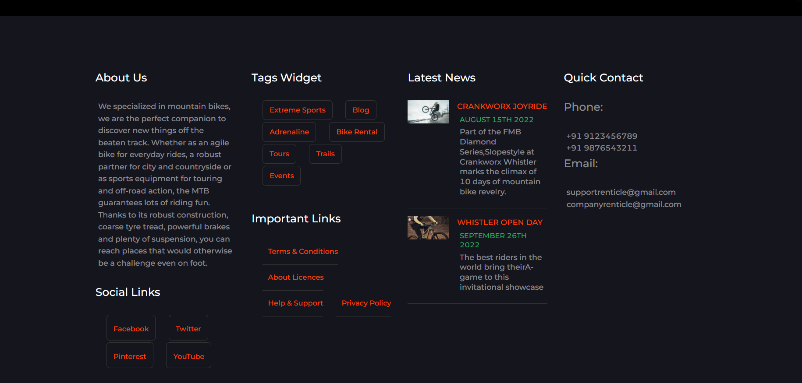
Frontend Output Screenshots

Slide 18
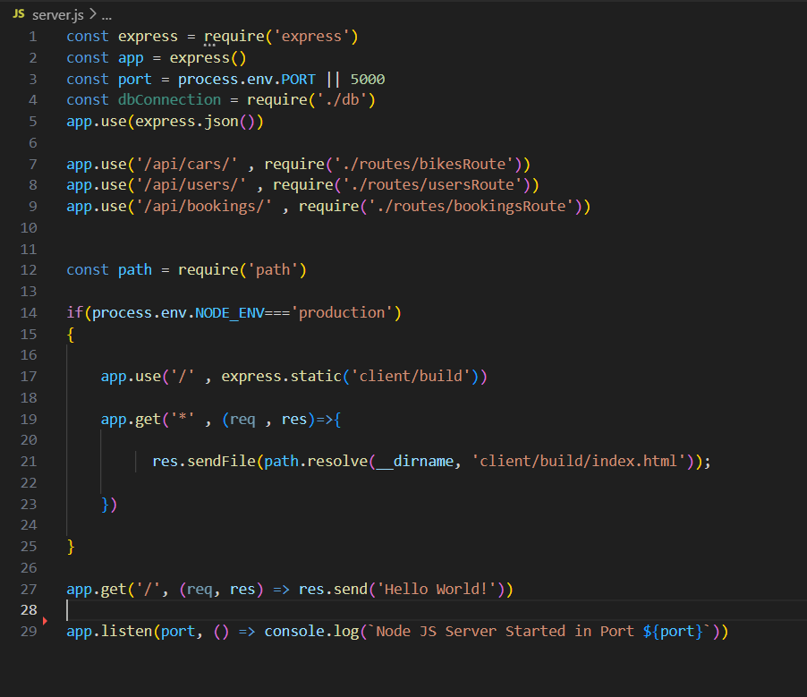
Backend Code Screenshot

Slide 19
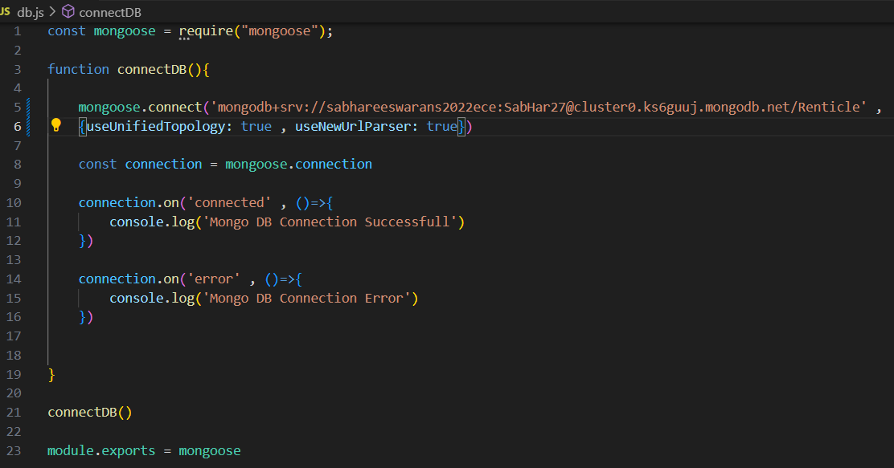
Database Connectivity Screenshot

Slide 20
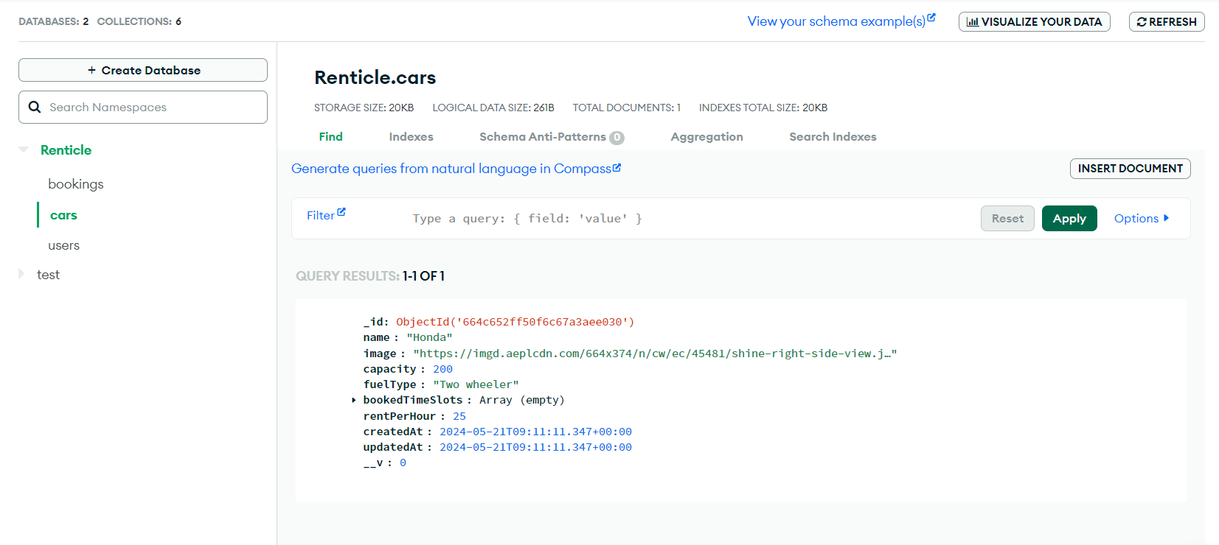
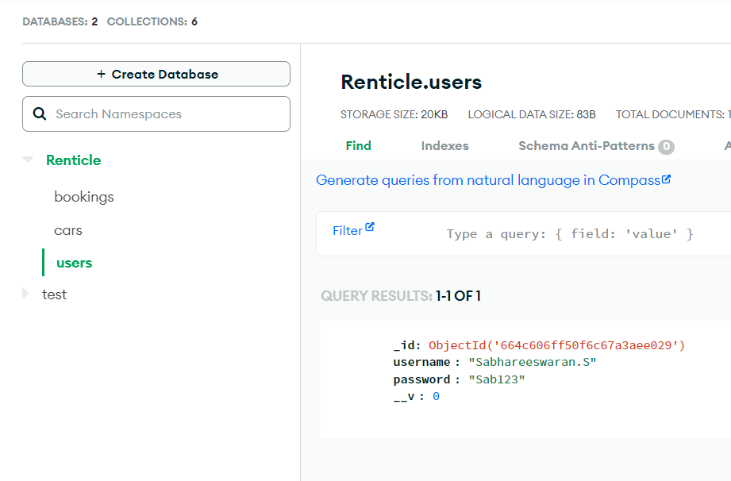
Database Output Screenshots

Slide 21
Conclusion
In conclusion, a forward-thinking bicycle rental system is essential for fostering sustainable urban mobility and enhancing the quality of life in cities.
By embracing advanced technologies, prioritizing user experience, and committing to environmental sustainability, such systems can become integral to urban transportation networks.
Developing a future-ready bicycle rental system involves integrating advanced technologies such as IoT for real-time tracking and AI for predictive maintenance , providing best routes for the users while enhancing user experience through sophisticated mobile apps, seamless public transport integration, and dynamic pricing models.
Expanding the fleet with electric bikes and incorporating solar-powered docking stations contribute to sustainability.

Slide 22


